Slide 1
Meeting 6/12
Joren Janzing

Slide 2
Agenda
Comparison SST reconstructions
Wavelets
Width of El Niño → not really far
Form

Slide 3
Differences between ERSST datasets

Slide 4
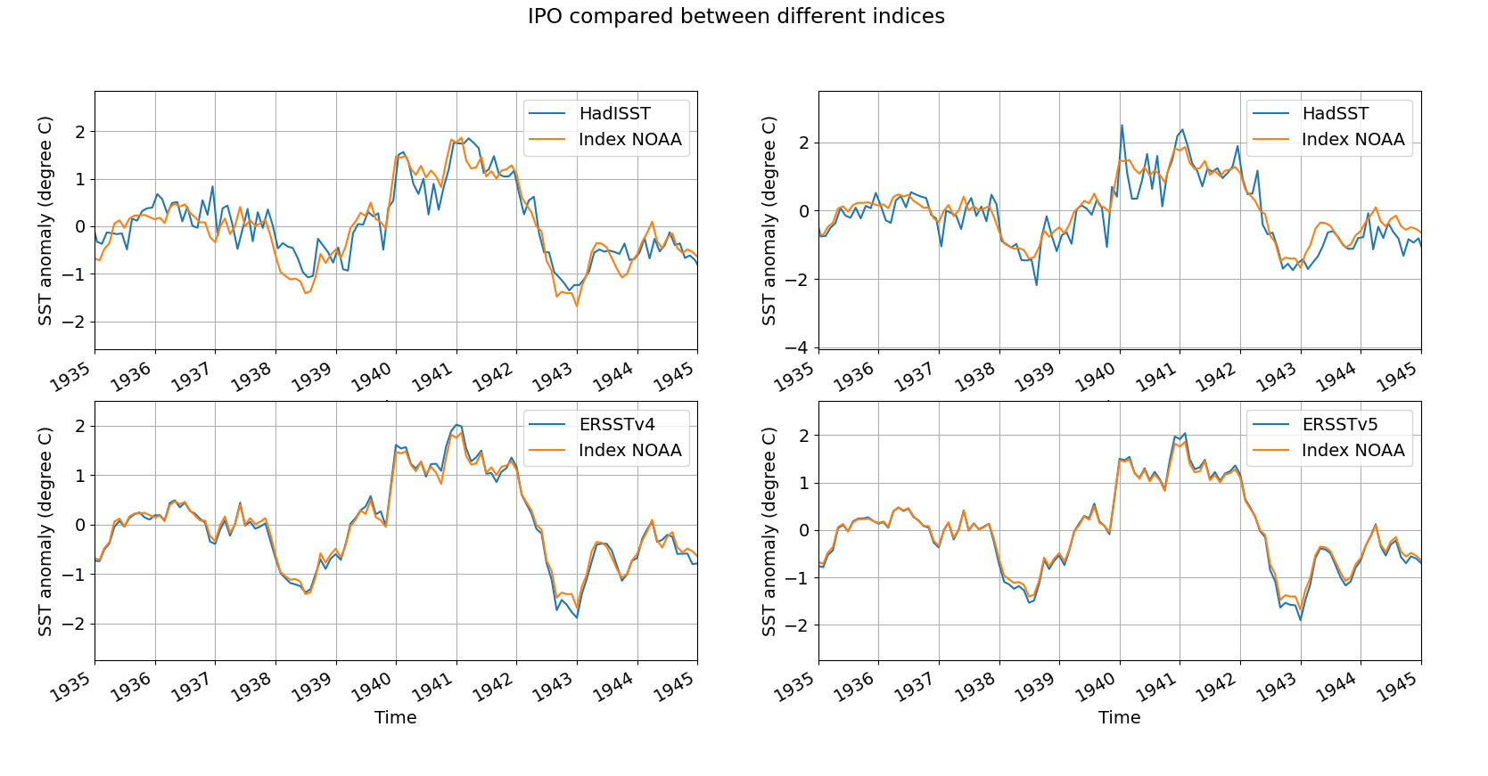
Henley, B. J., Gergis, J., Karoly, D. J., Power, S., Kennedy, J., & Folland, C. K. (2015). A tripole index for the interdecadal Pacific oscillation. Climate Dynamics, 45(11-12), 3077-3090.
IPO: index should be based on ERSSTv5

Slide 5
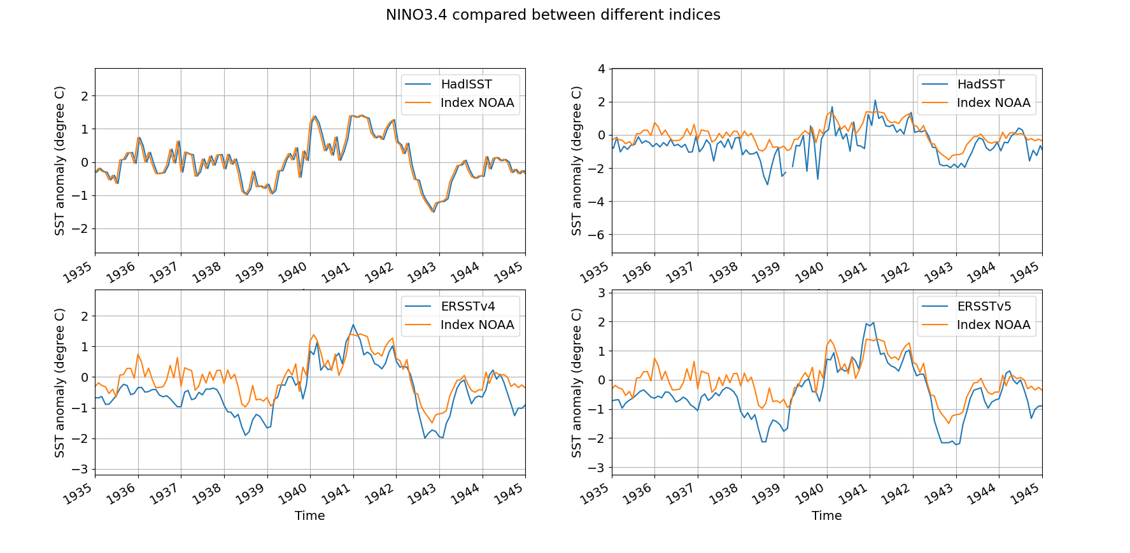

Slide 6
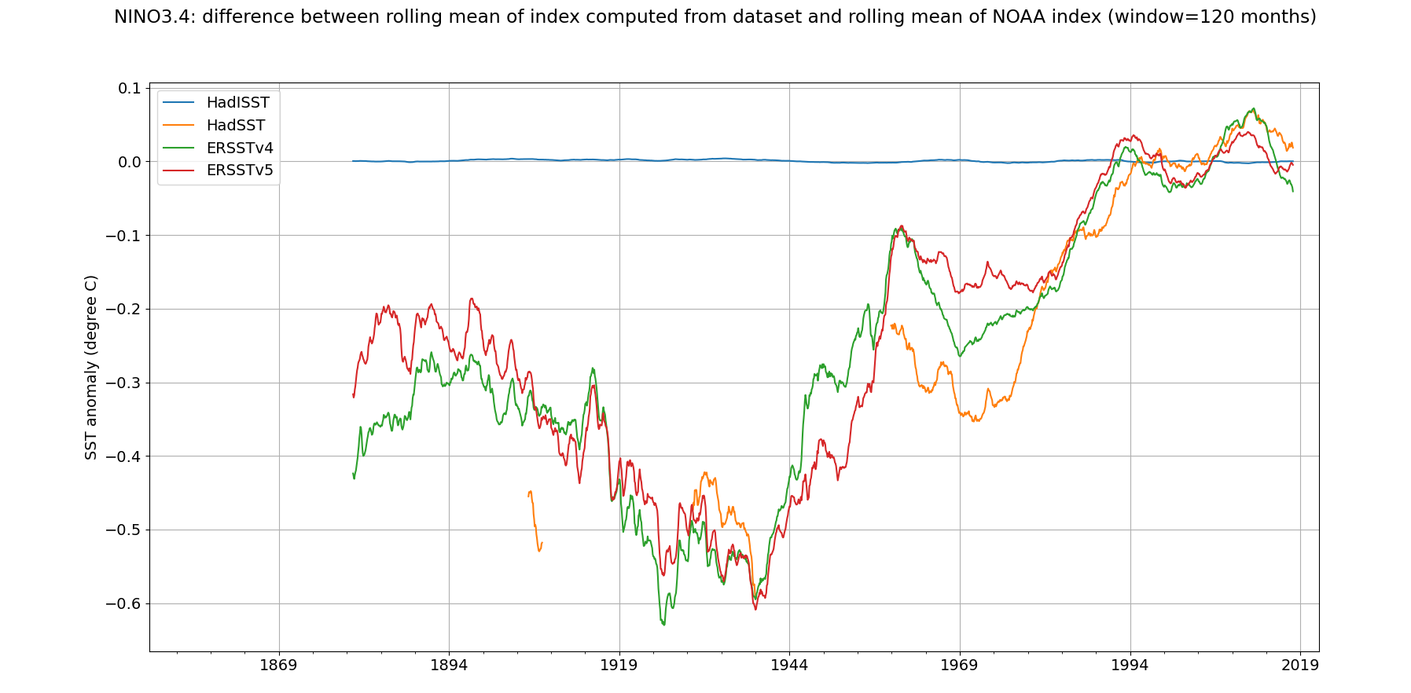

Slide 7
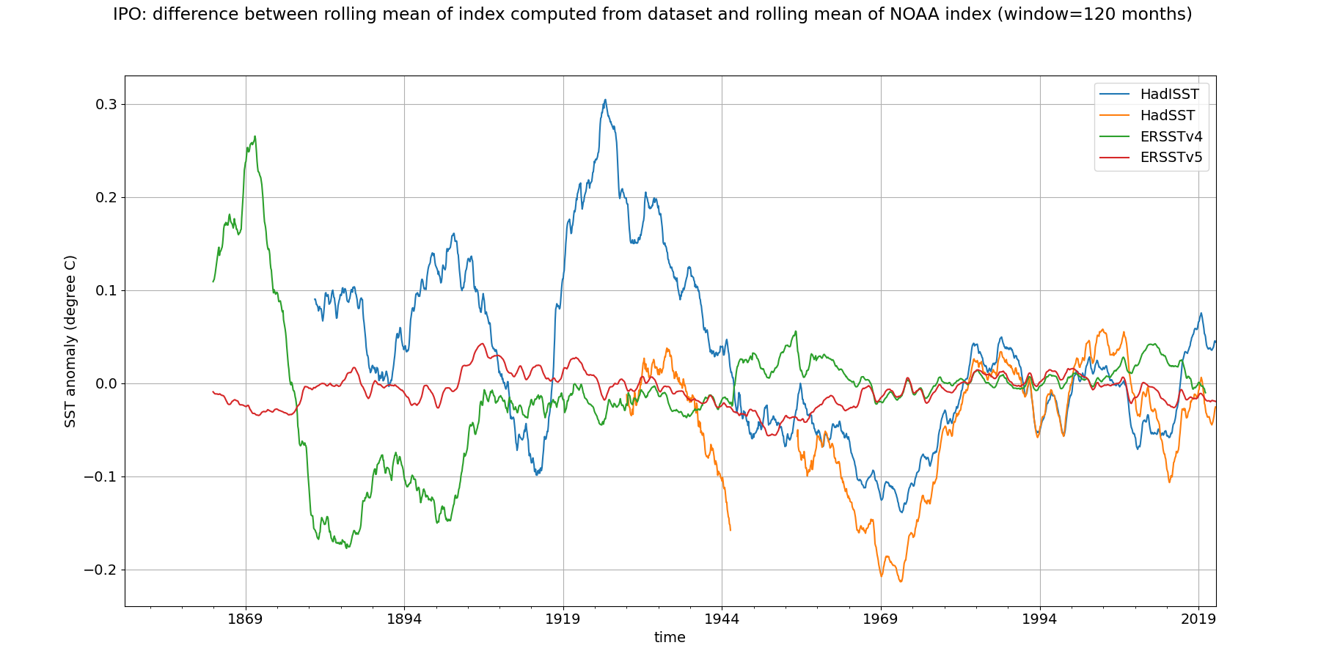

Slide 8
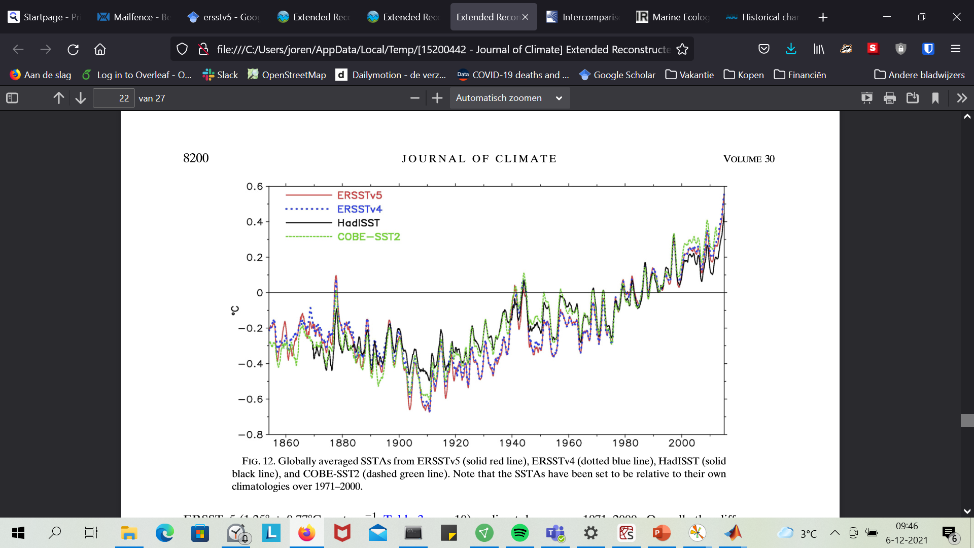
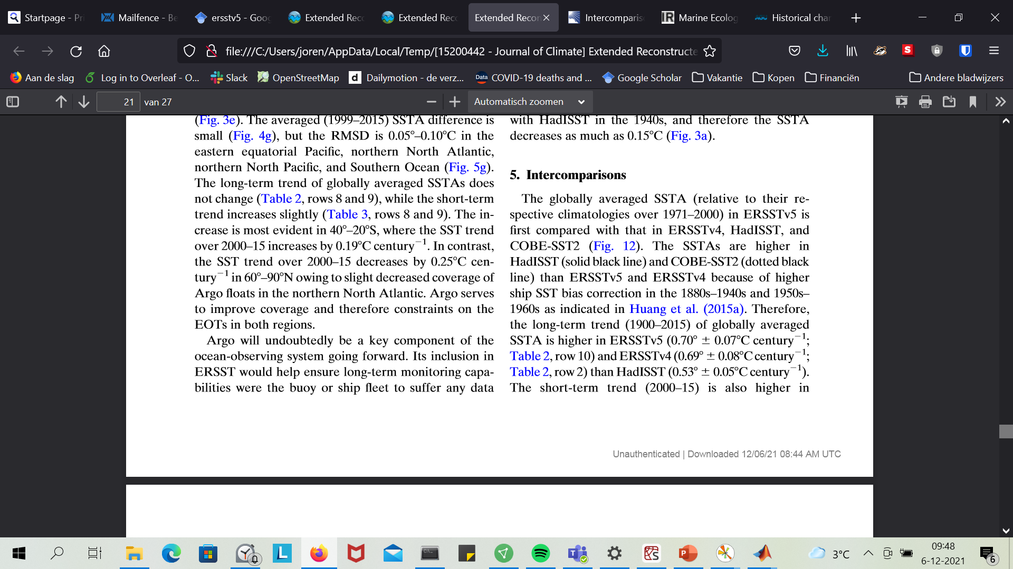
Huang et al, 2017

Slide 9
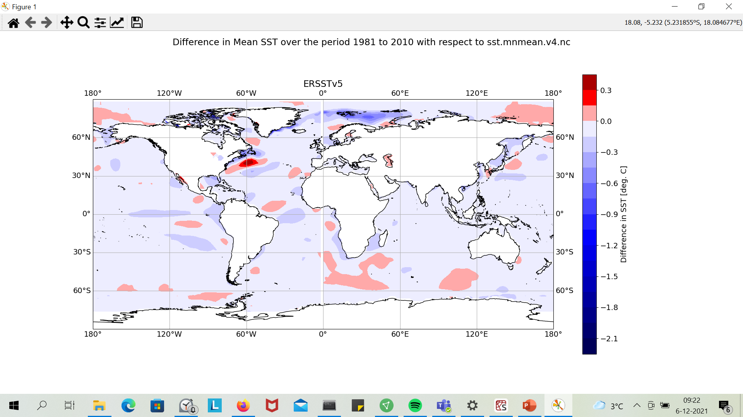
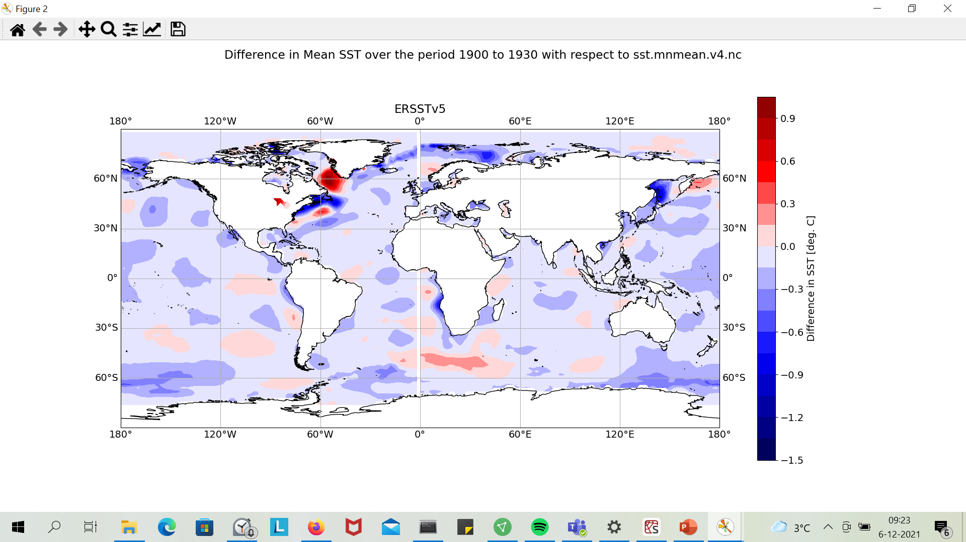

Slide 10
ENSO Event 1940s

Slide 11
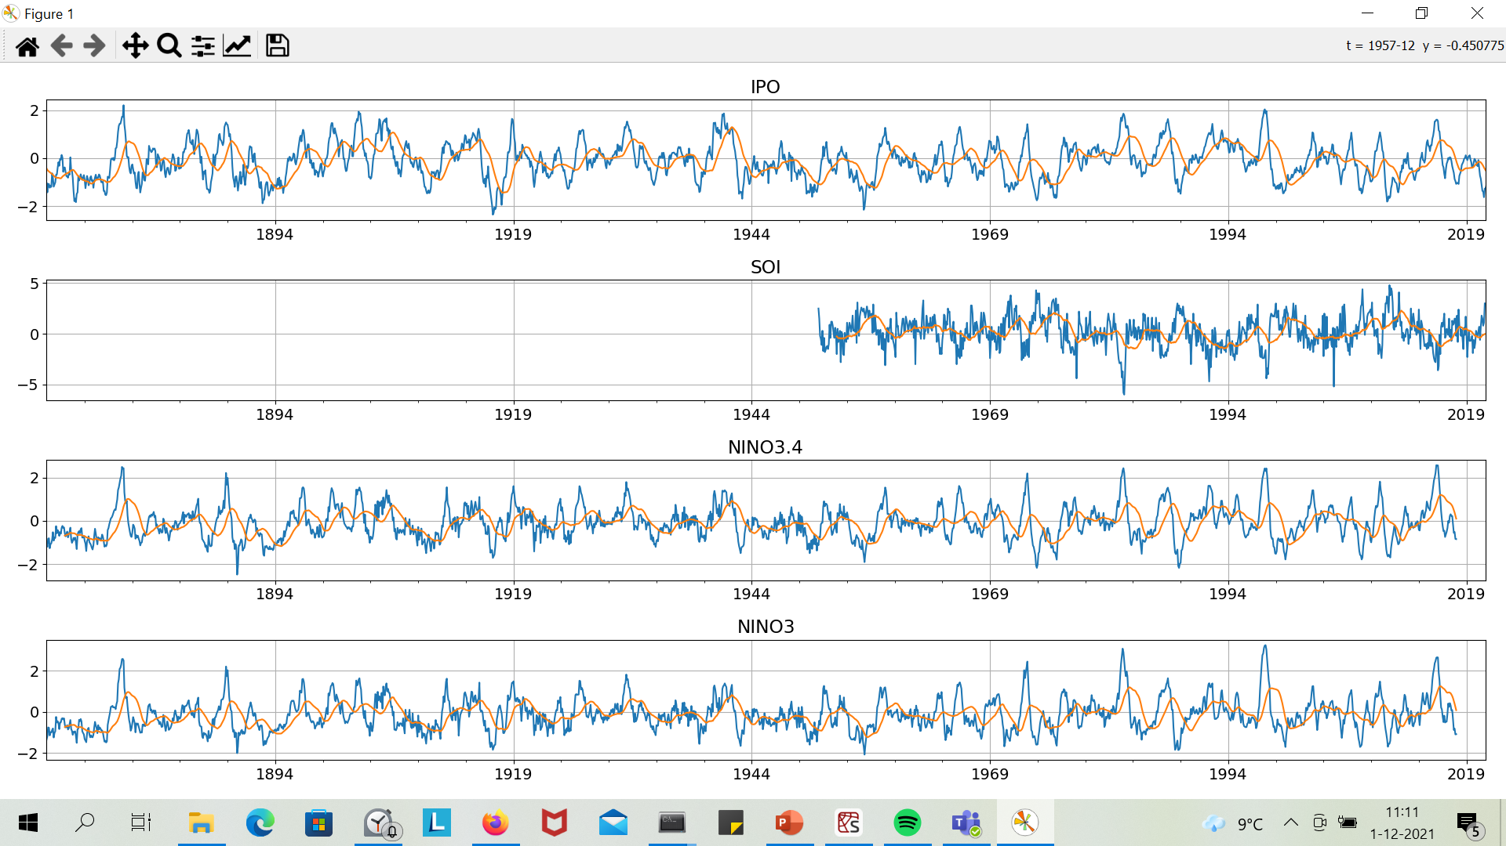
Time series of the Indices

Slide 12
Wavelets

Slide 13
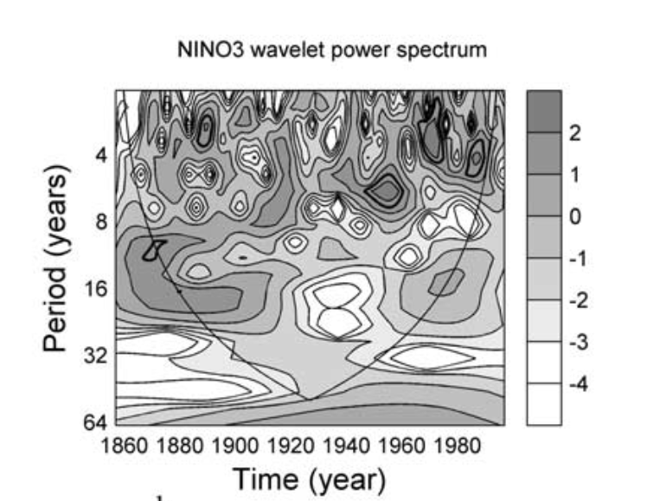
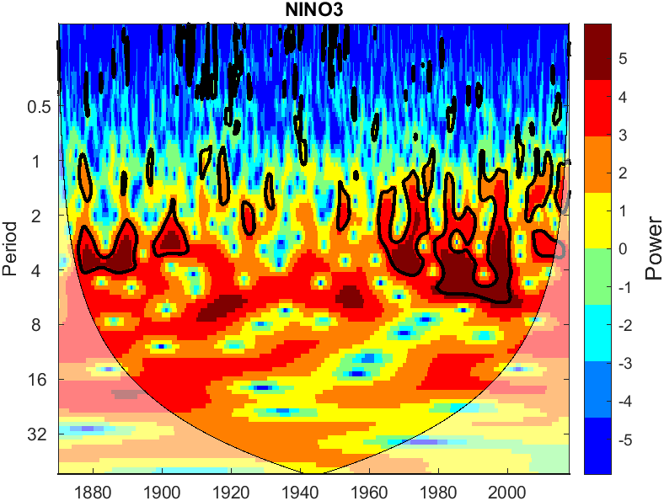
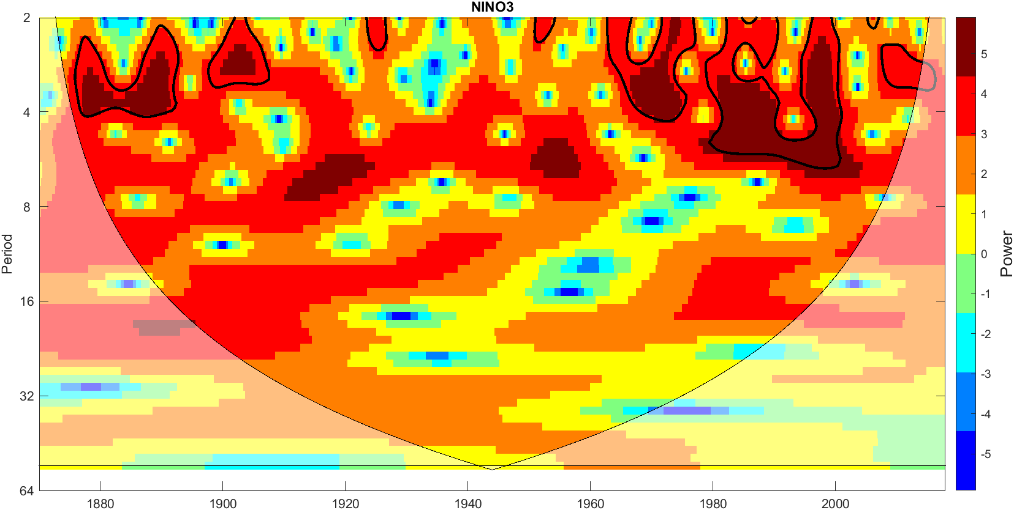
Jevrejeva et al., 2003

Slide 14
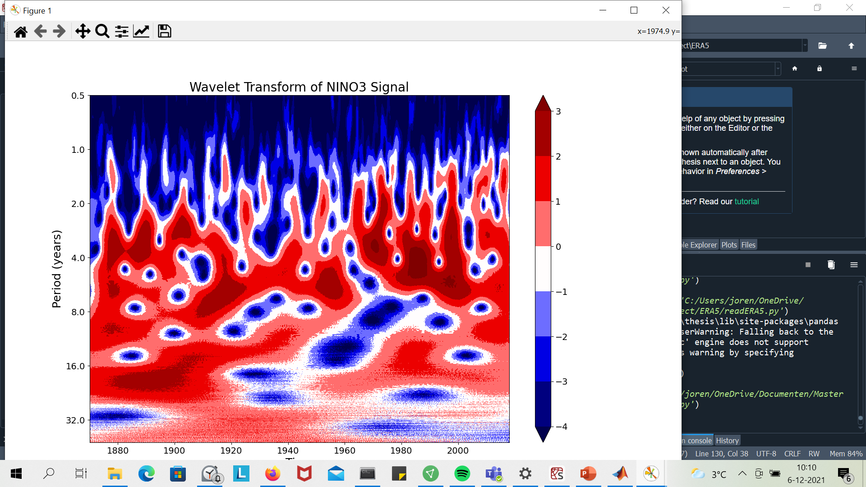
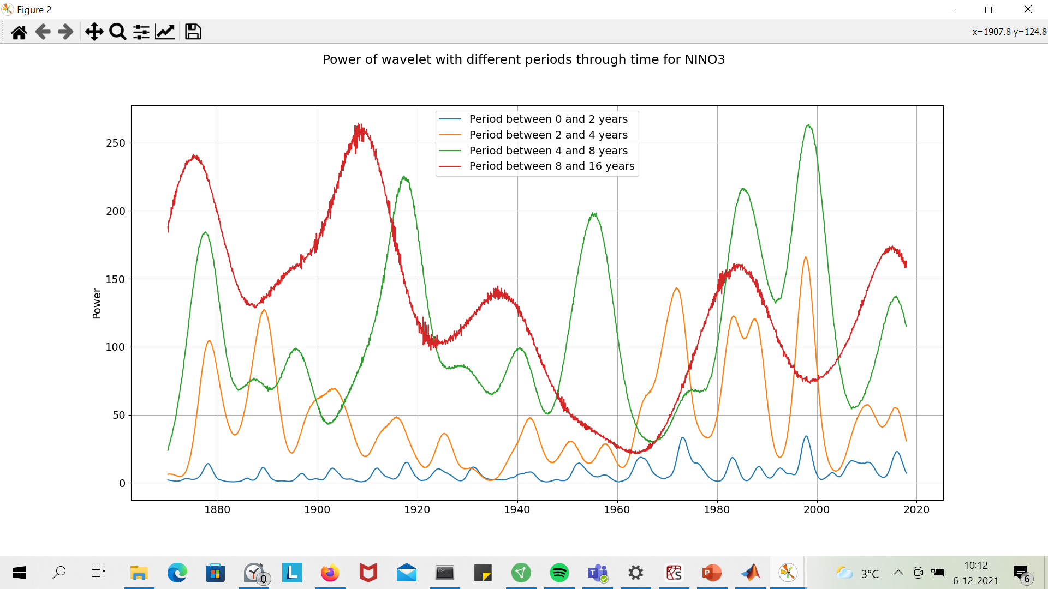
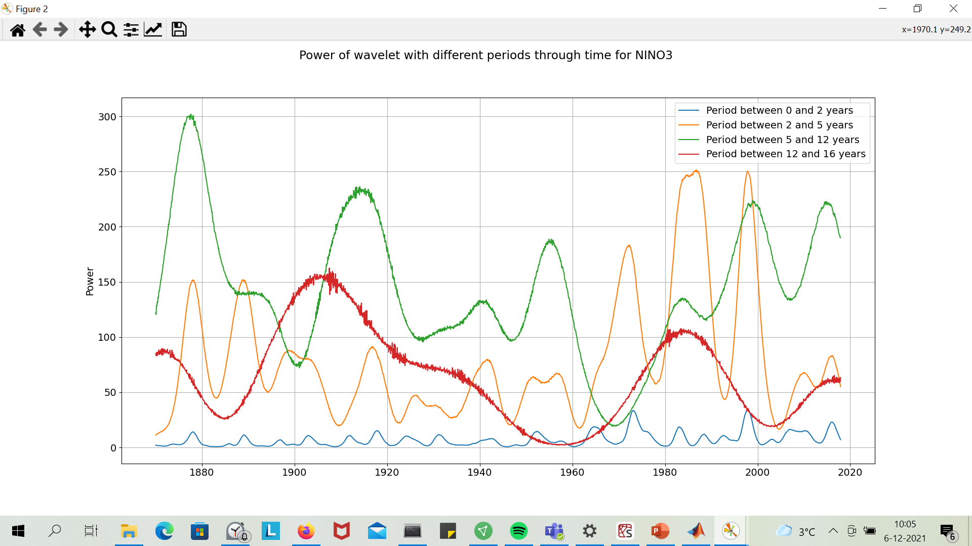
How to normalize?

Slide 15
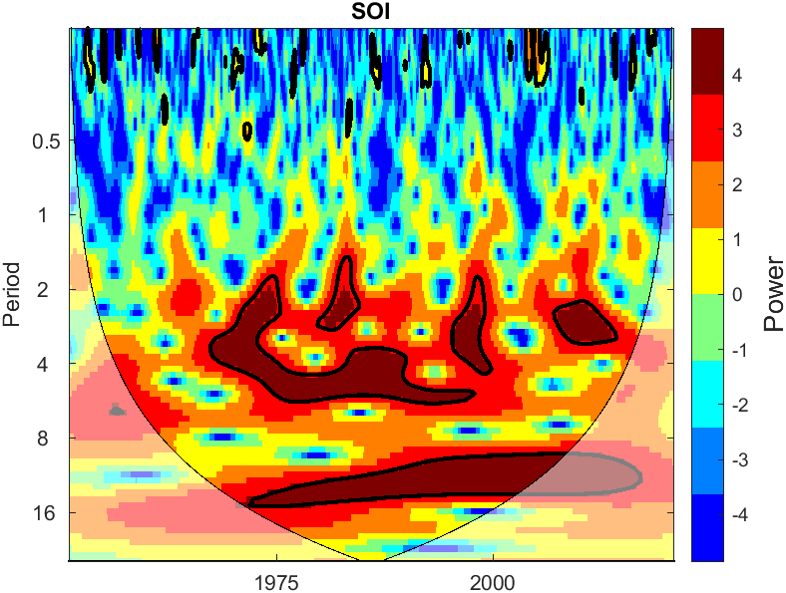
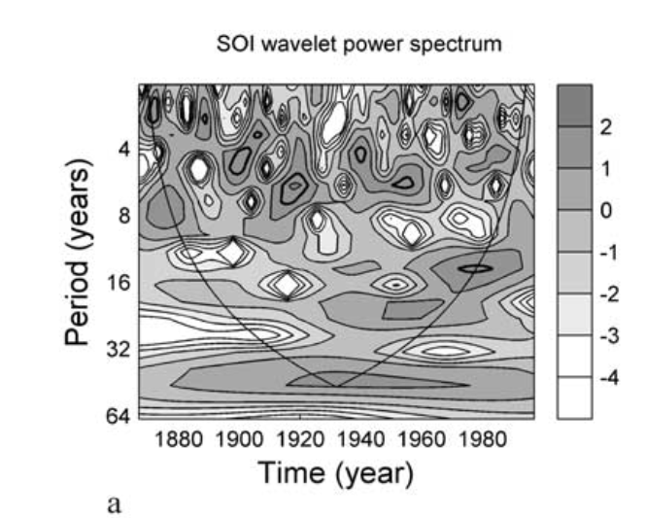
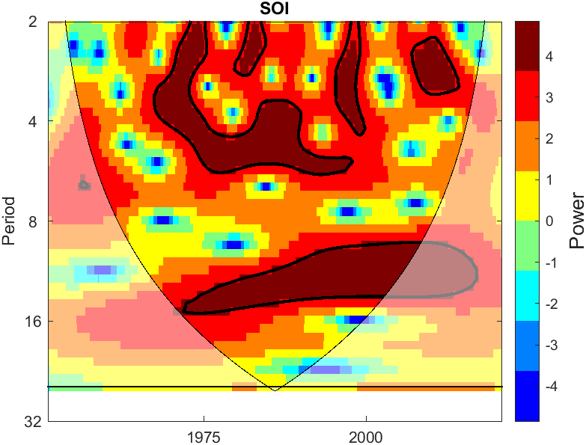

Slide 16
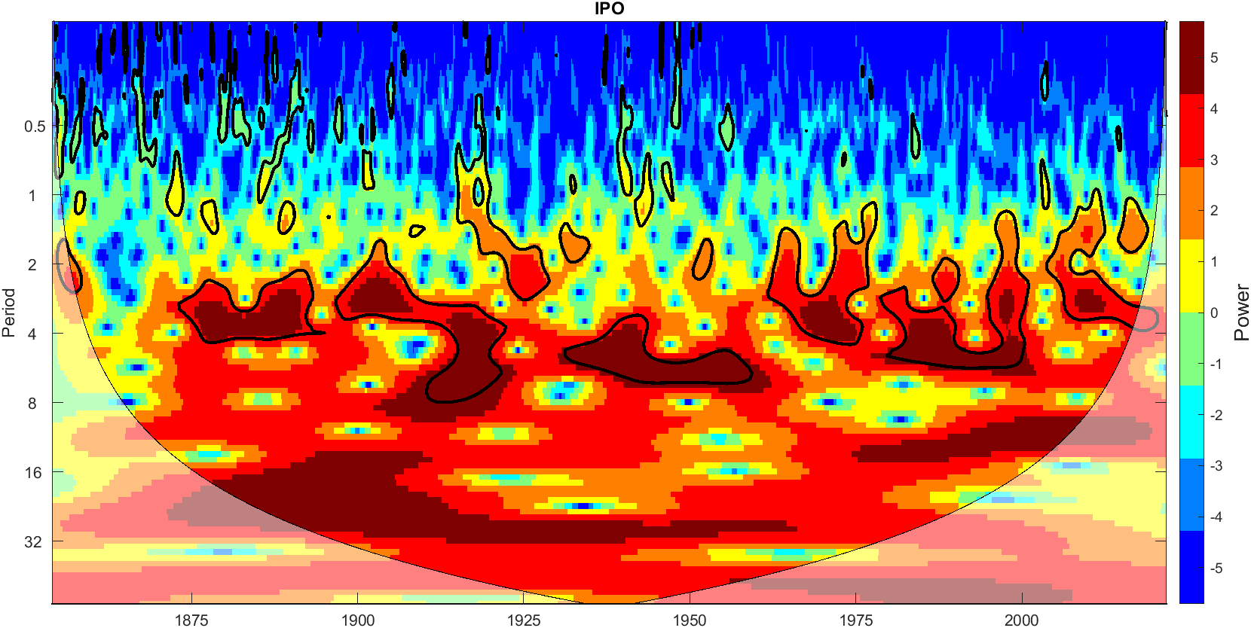

Slide 17
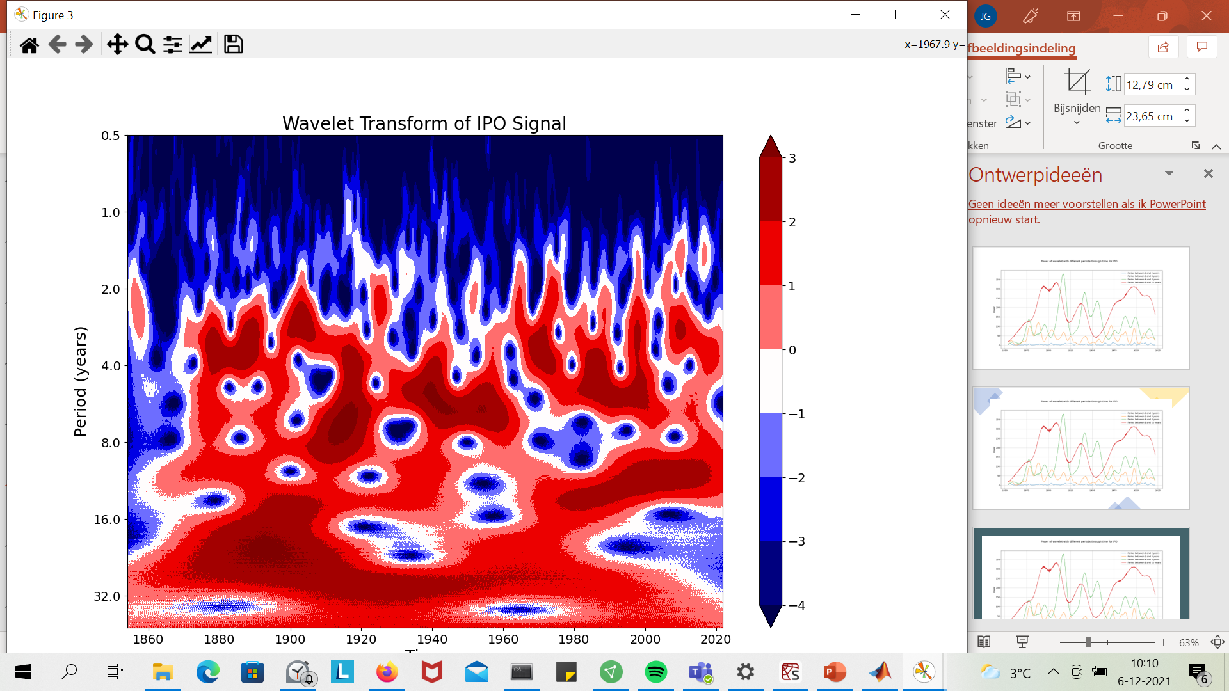
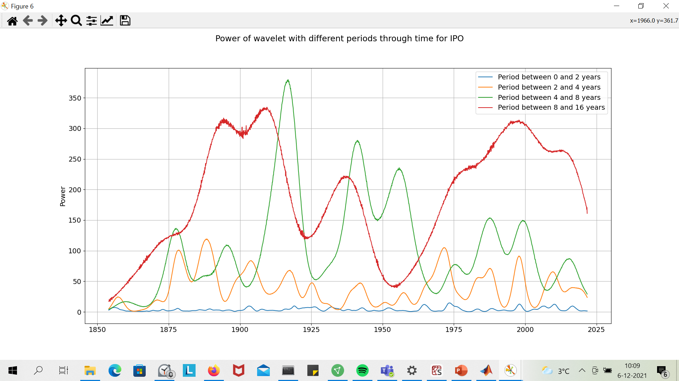

Slide 18
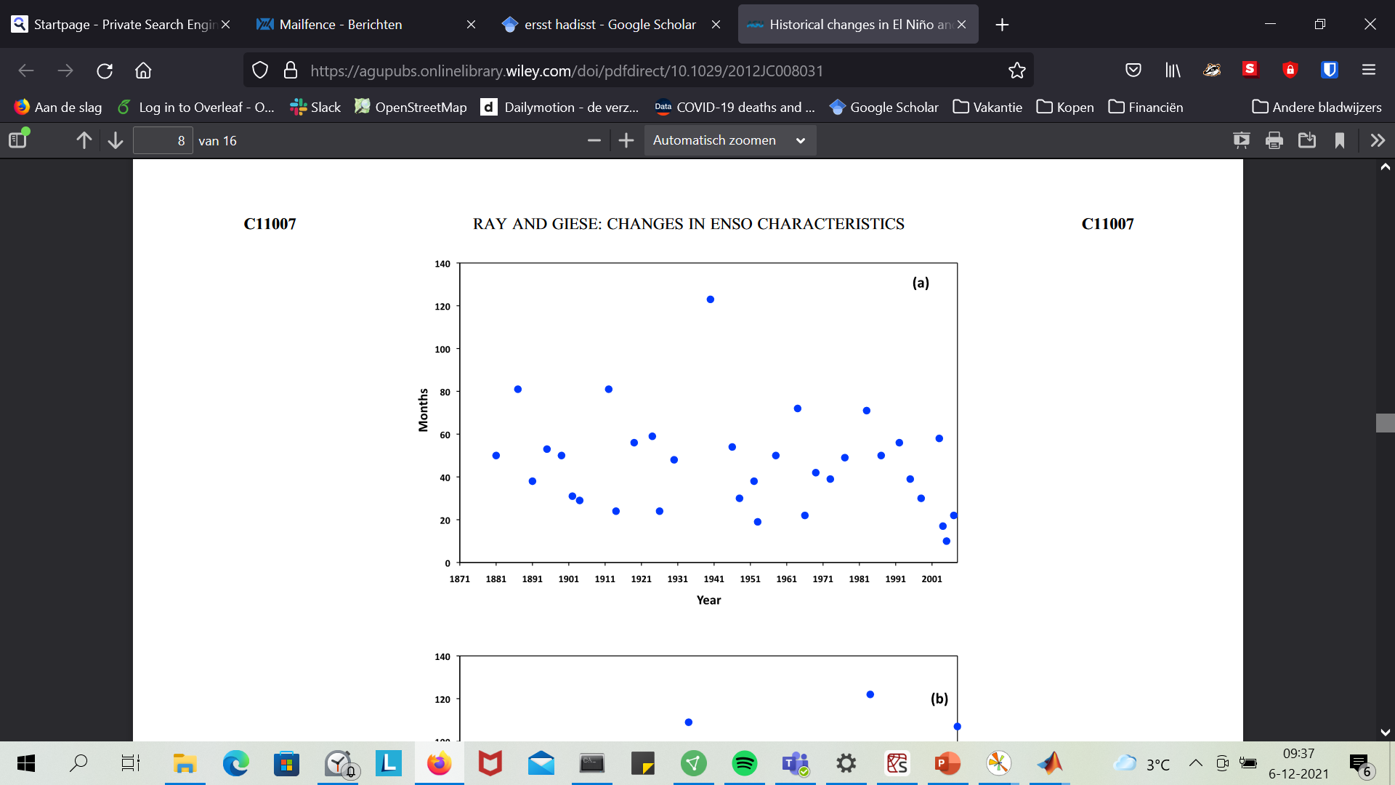
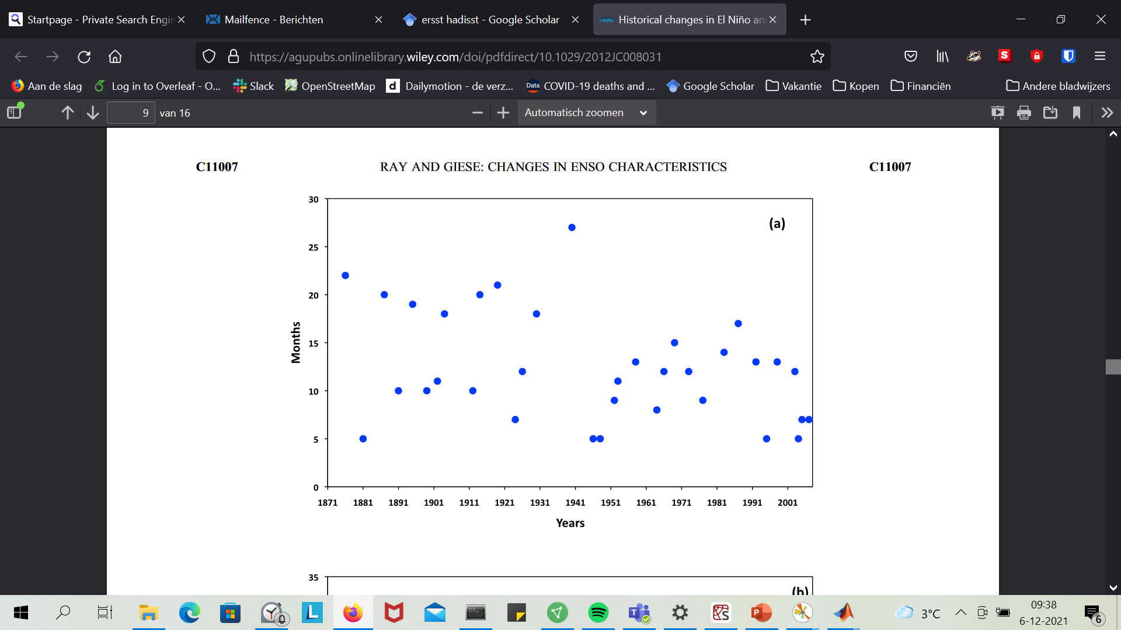
Width of ENSO
Months before El Nino
Duration of El Nino

Slide 19
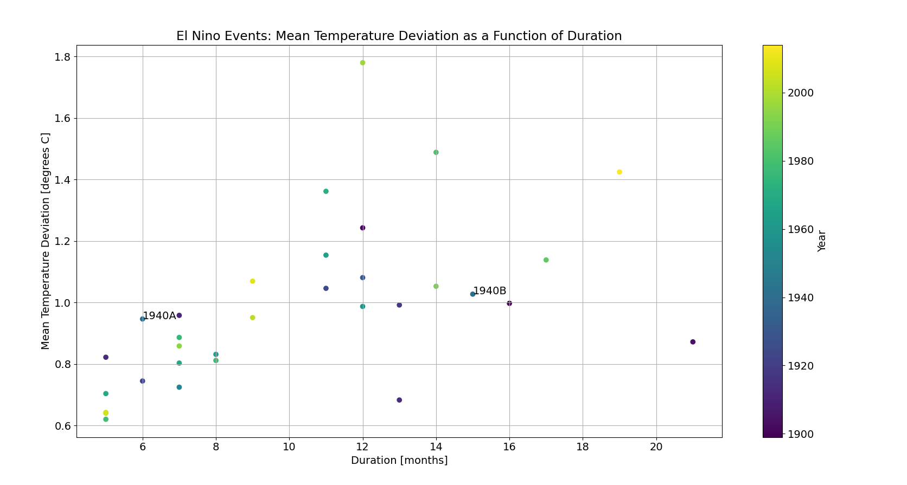

Slide 20
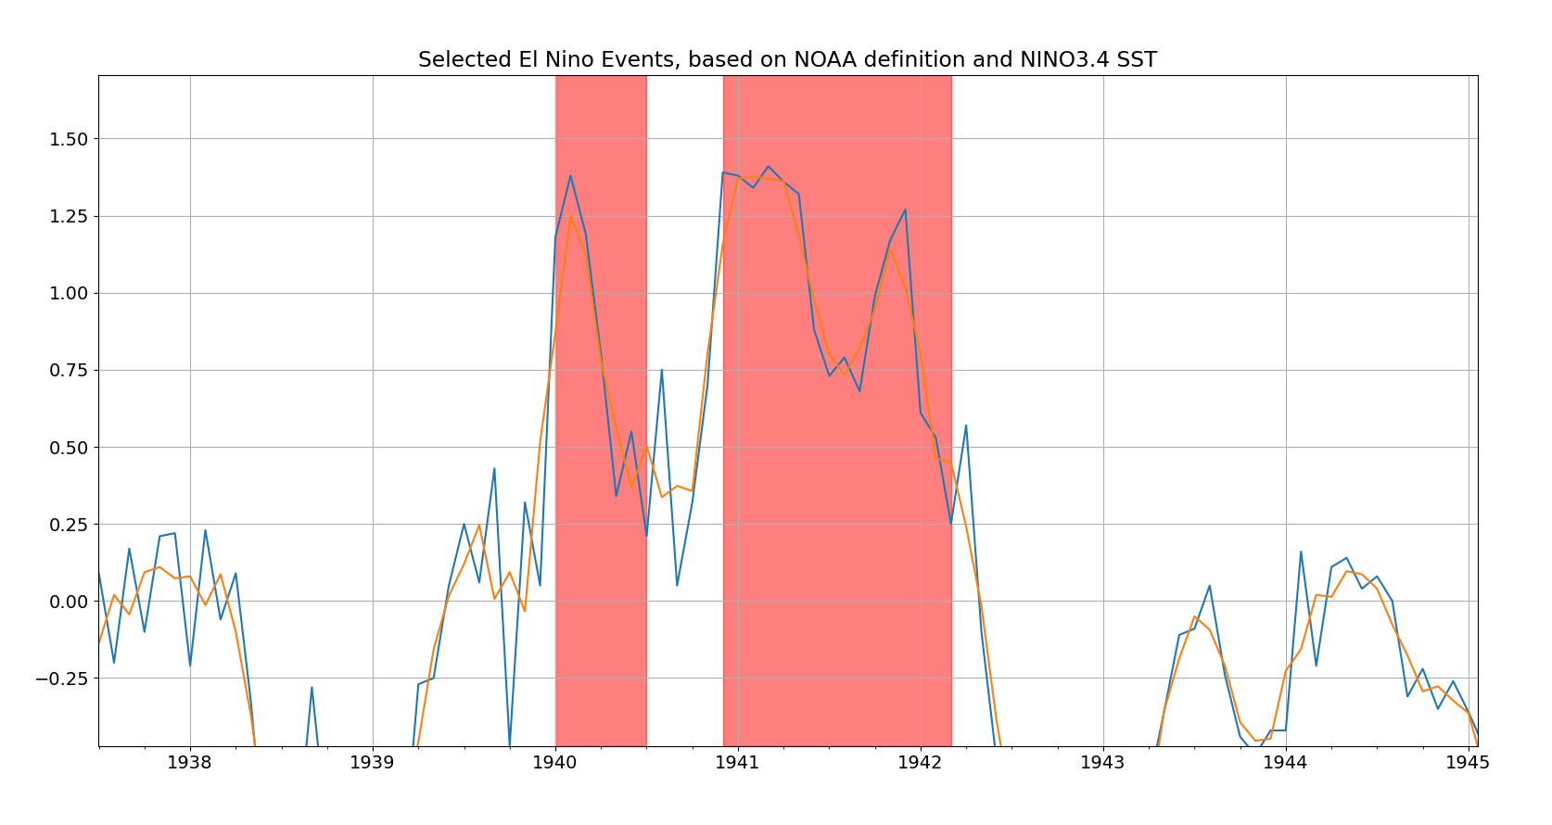

Slide 21
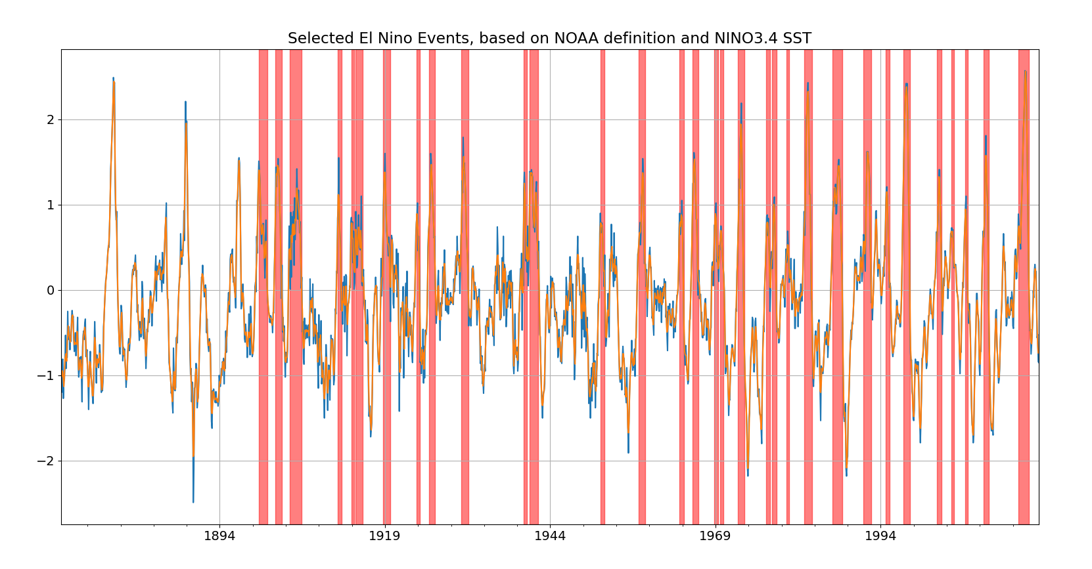

Slide 22
Next week:
Form!
Goals?
ENSO events
Connection with Wind with IPO (ENSO)→ longer term reconstruction ERA5 or B?; Variability, also with NAO and SAM.
NAO
Basal melt?
Literature

Slide 23
Behind this some old slides

Slide 24
Probability of occurence: Not yet reached

Slide 26
Basal Melt

Slide 27
Literature

Slide 28
Time series of the Indices

Slide 29
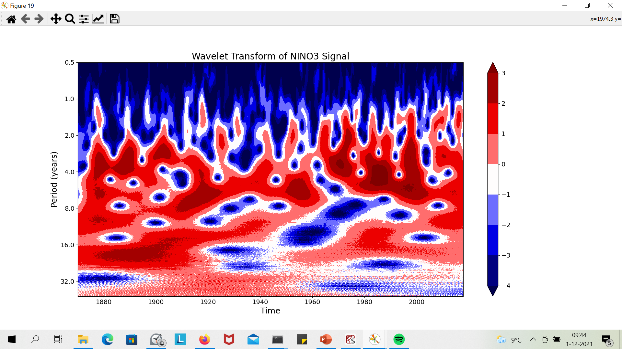
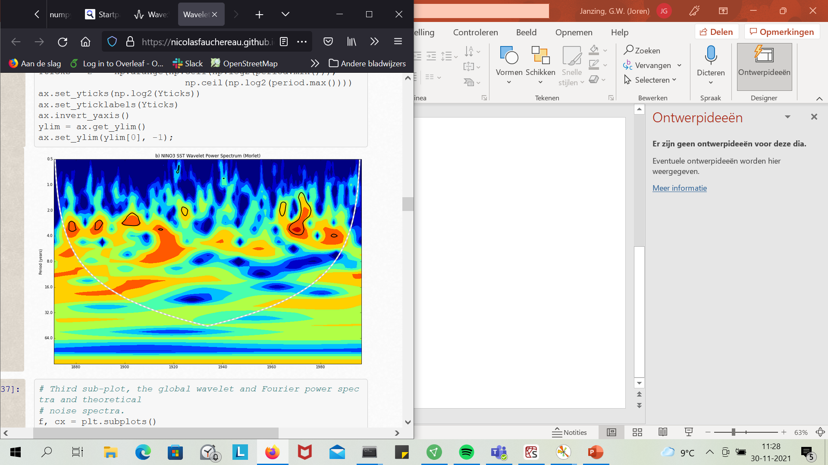
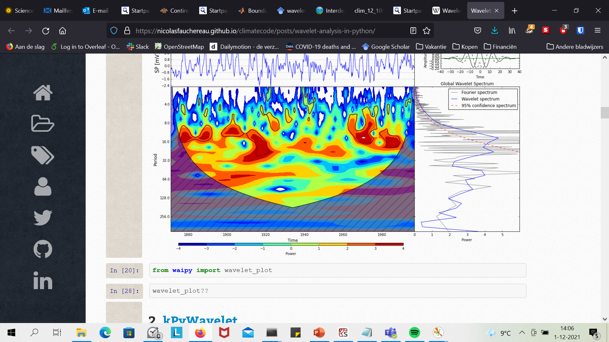
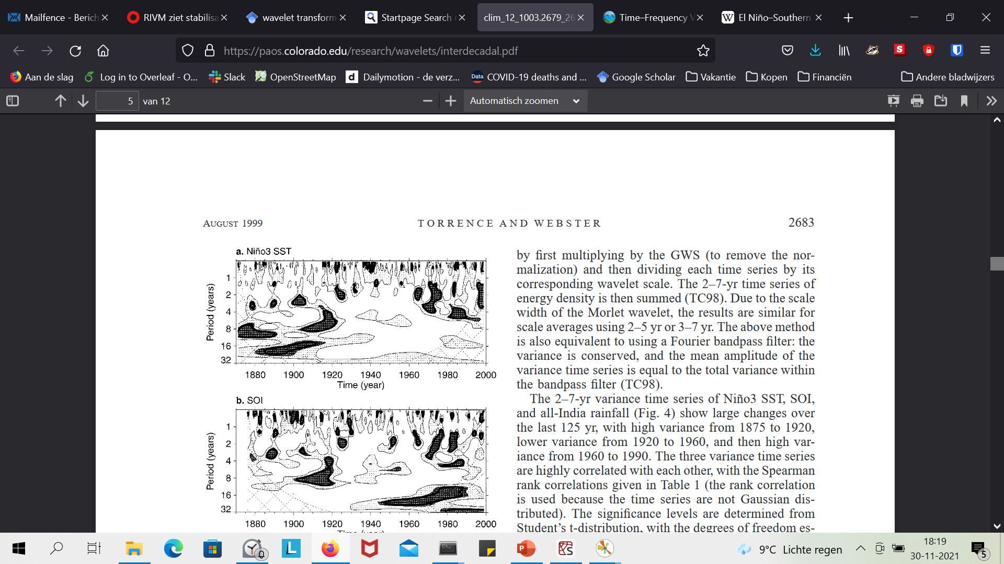
Comparing with results that I could find online
https://nicolasfauchereau.github.io/climatecode/posts/wavelet-analysis-in-python/;
Complex Morlet 1.5 band width, 1.0 center frequency
Code based on:
https://towardsdatascience.com/wavelet-fourier-analysis-on-the-enso-and-monsoon-data-in-python-31504eeadc2c;
Terrence and Webster, 1999

Slide 30
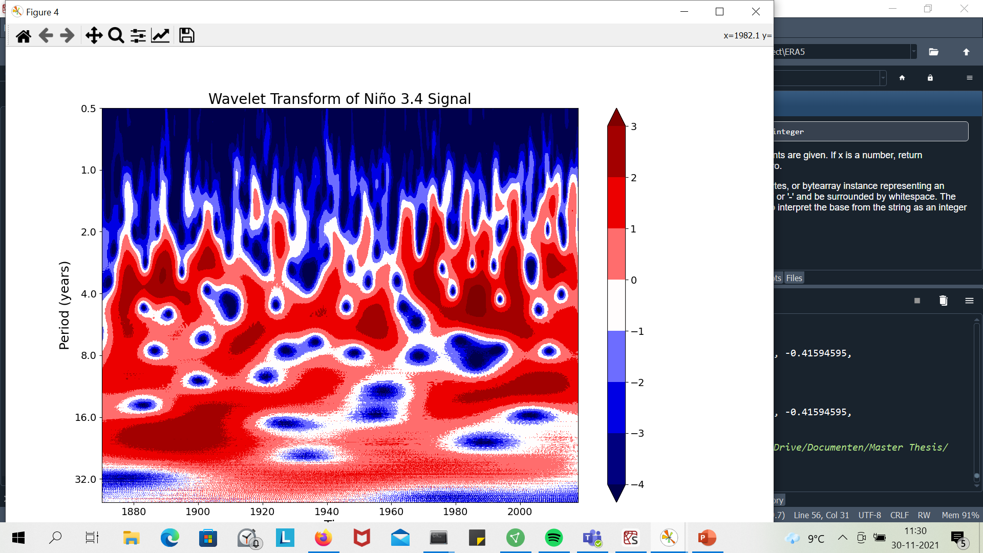
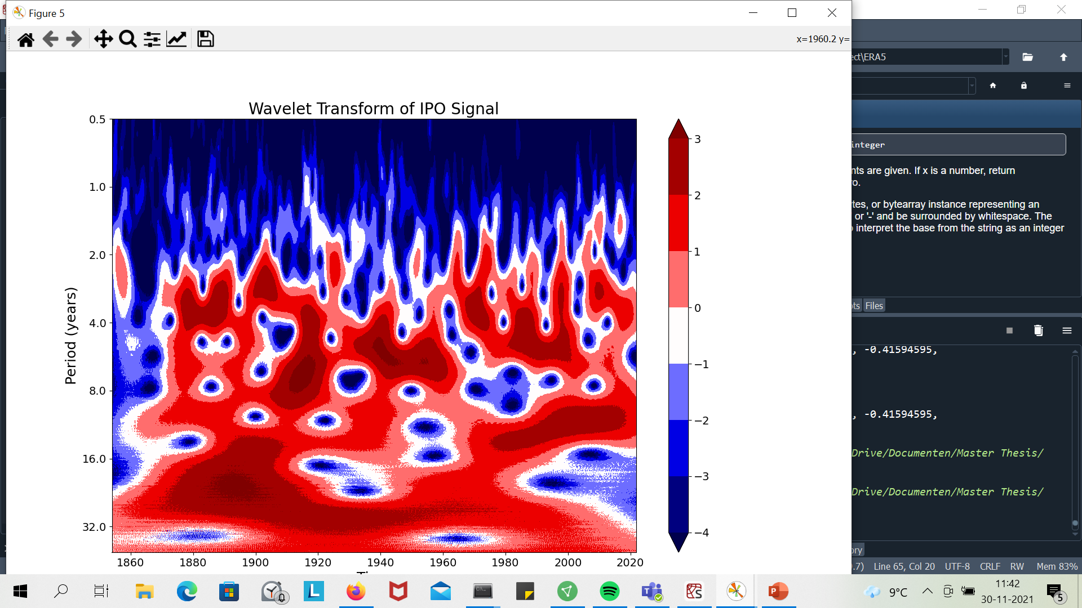
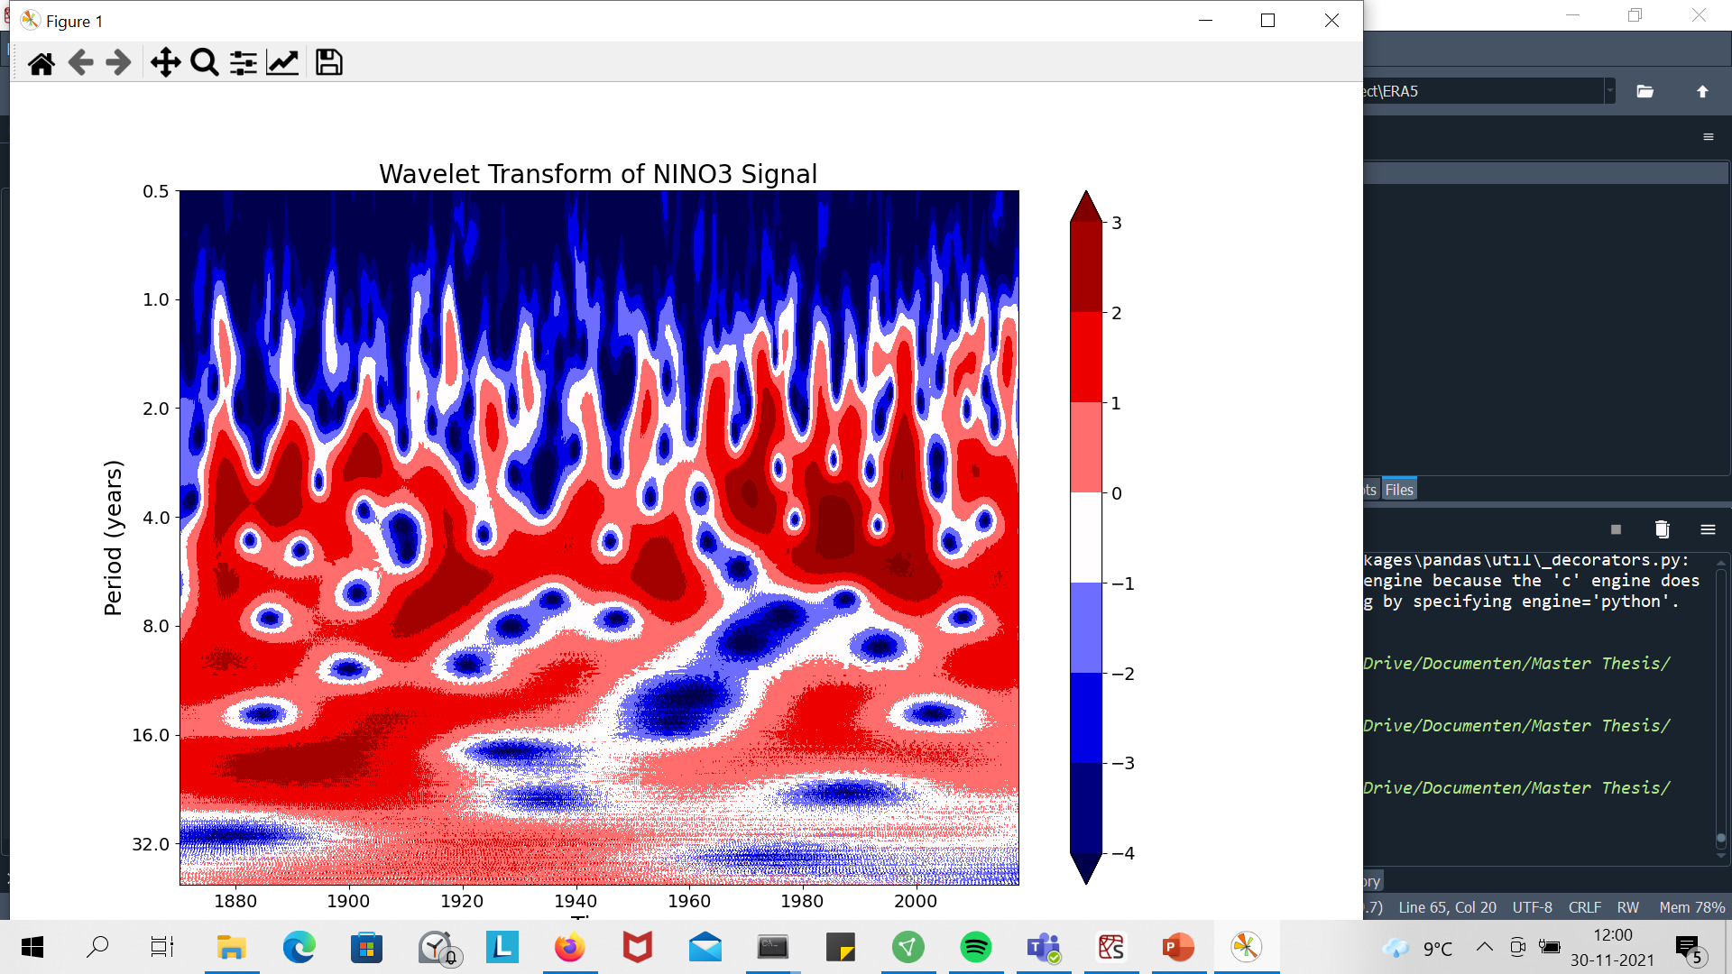
Differences between indices:
All with Complex Morlet Wave

Slide 31
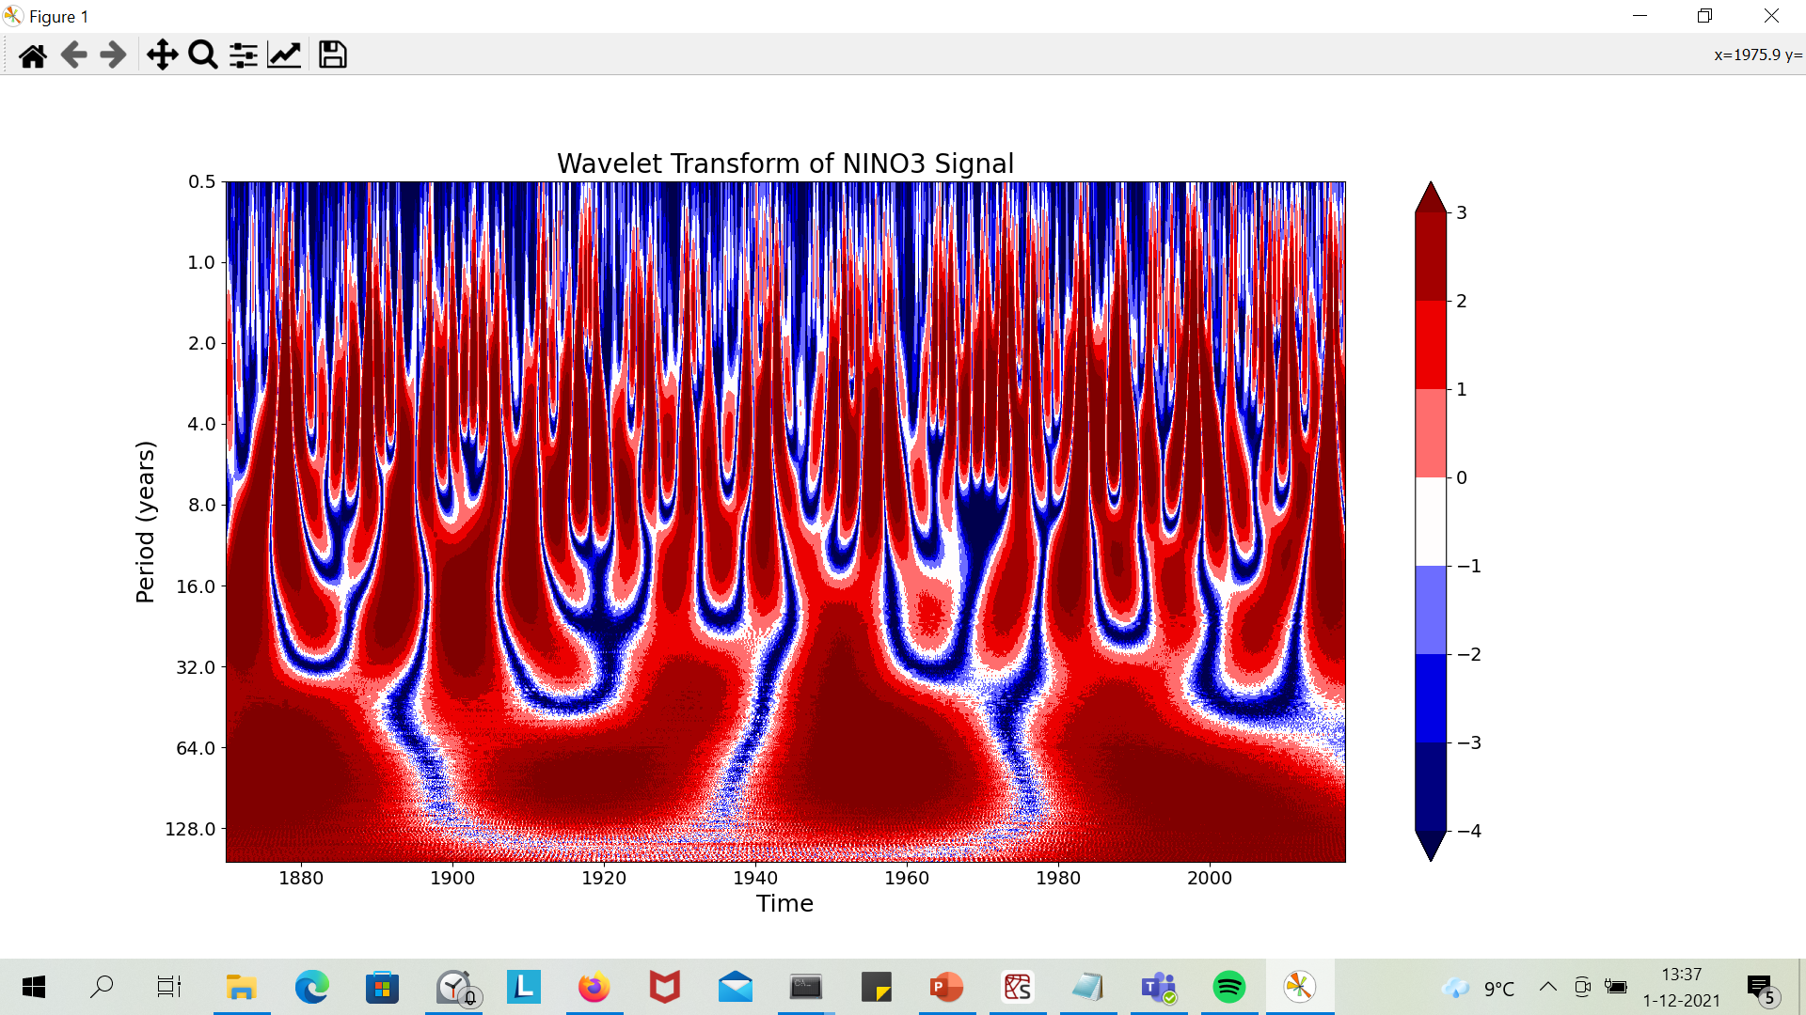
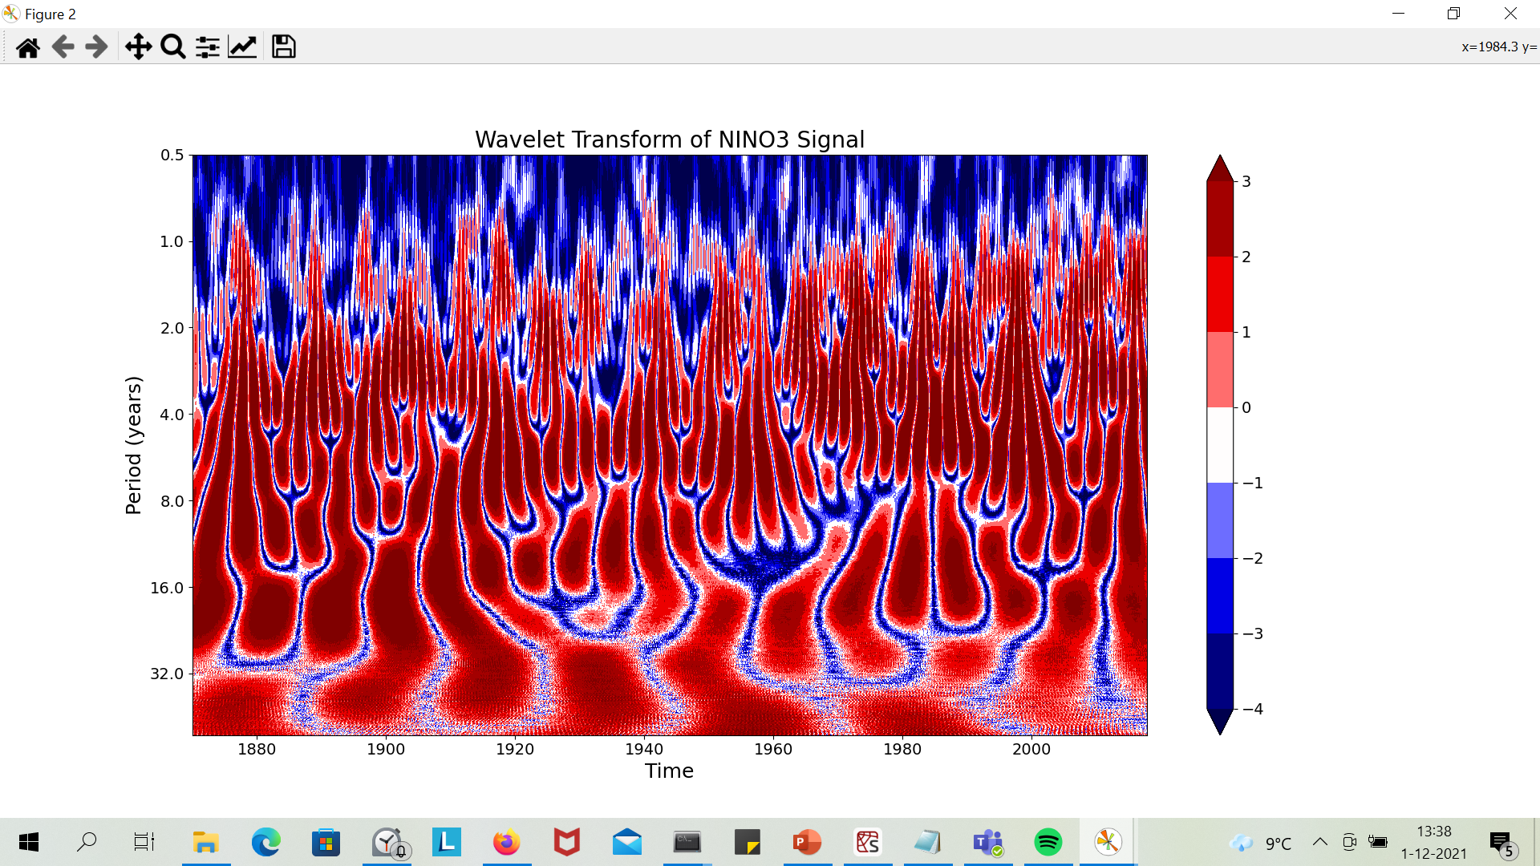
Effect of wavelet type
Mexican hat wavelet
Morlet (normal)

Slide 32
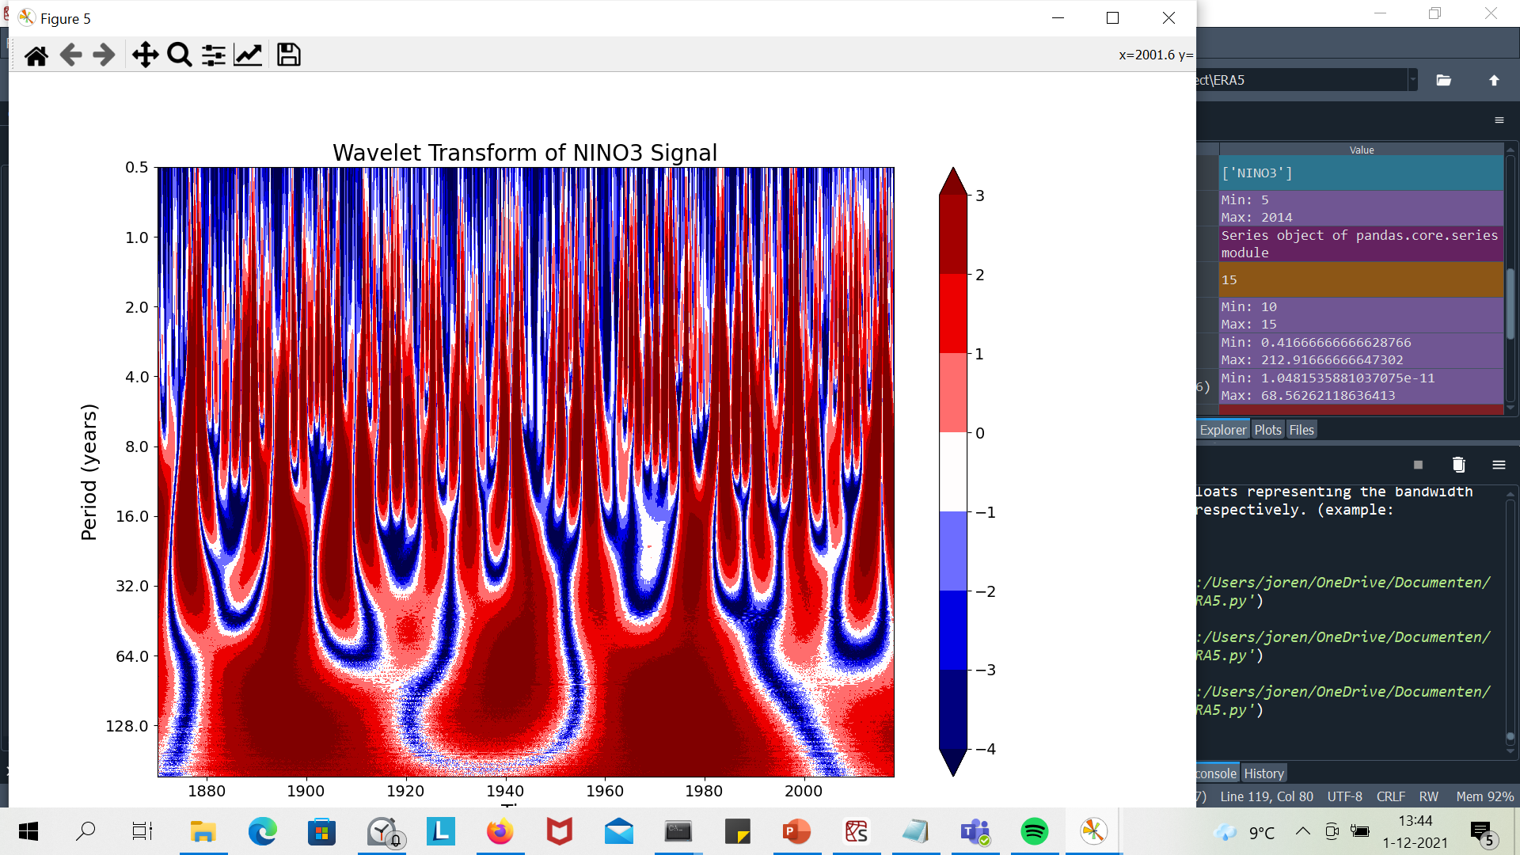
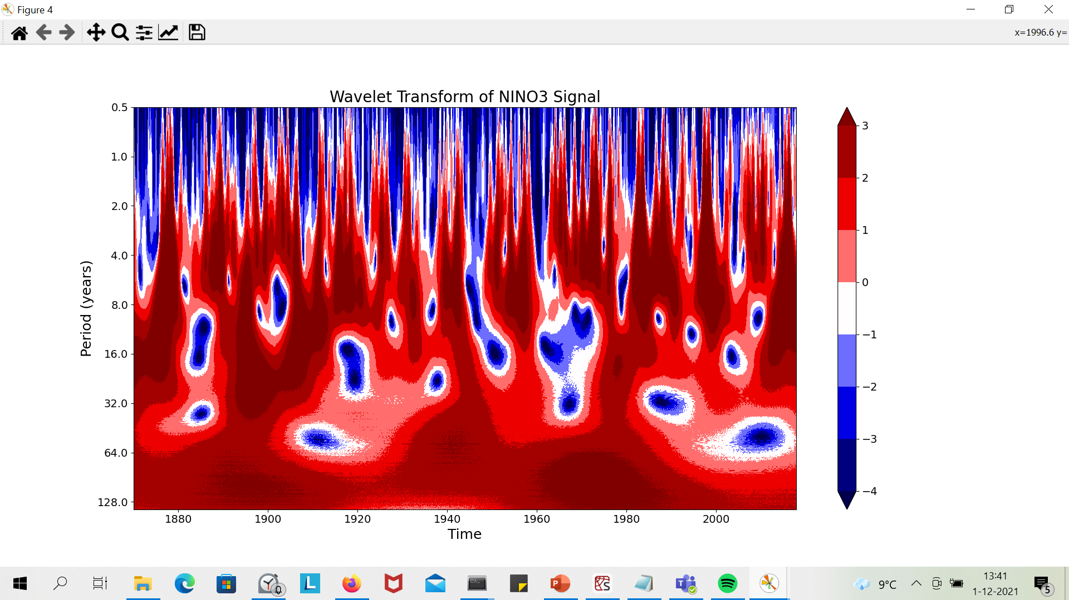
Effect of wavelet type
Gaussian (1st order derivative)
Complex Gaussian (1st order derivative)

Slide 33
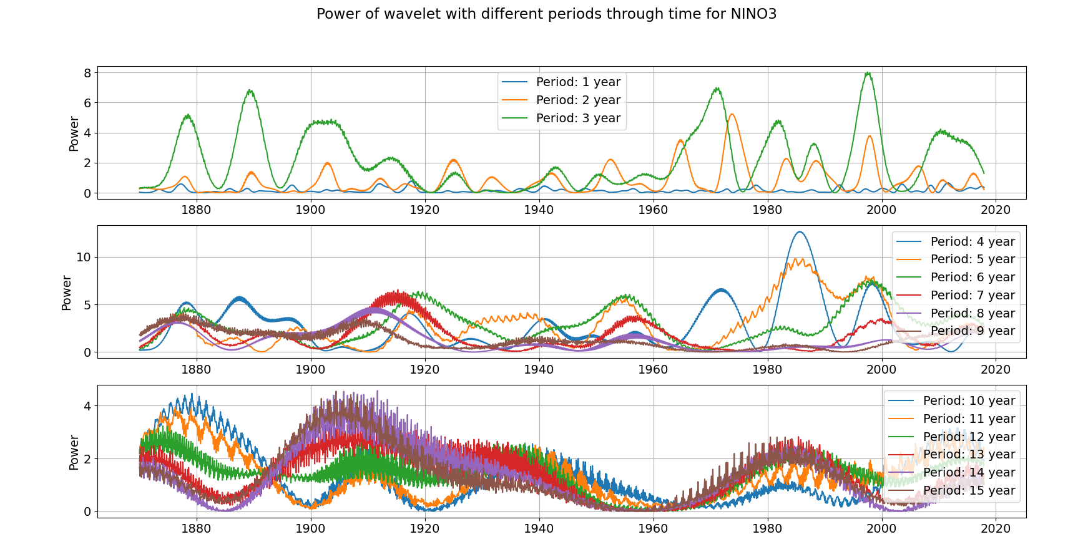
Complex Morlet 1.5 bandwith, 1.0 center frequency
Time series of the Power of specific periodicities

Slide 34
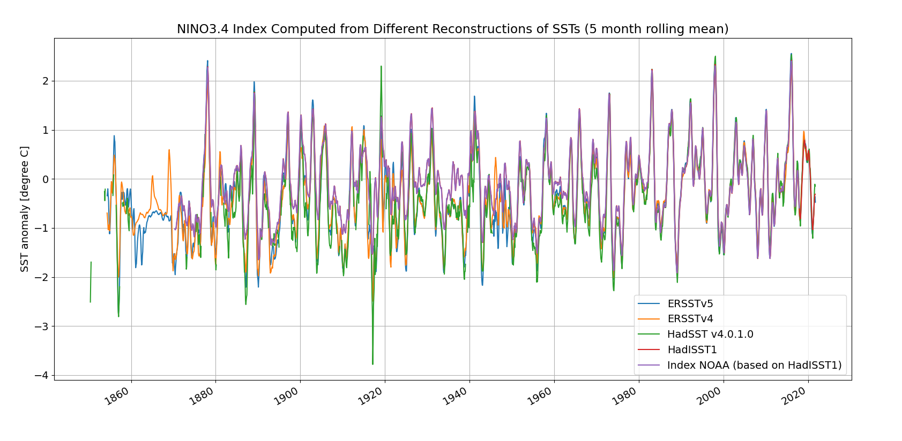
All with respect to average between 1981-2010: https://psl.noaa.gov/gcos_wgsp/Timeseries/Nino34/
ERSST compute more T rise through time.

Slide 35
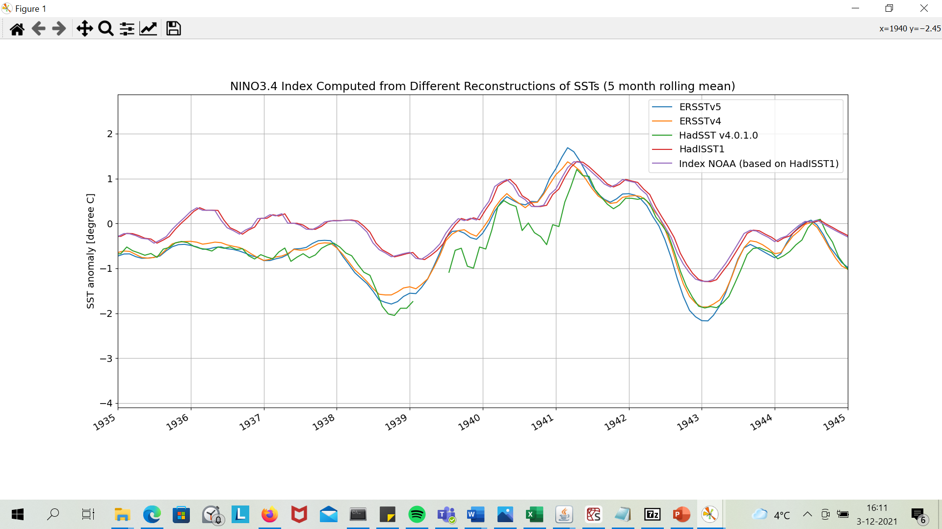

Slide 36
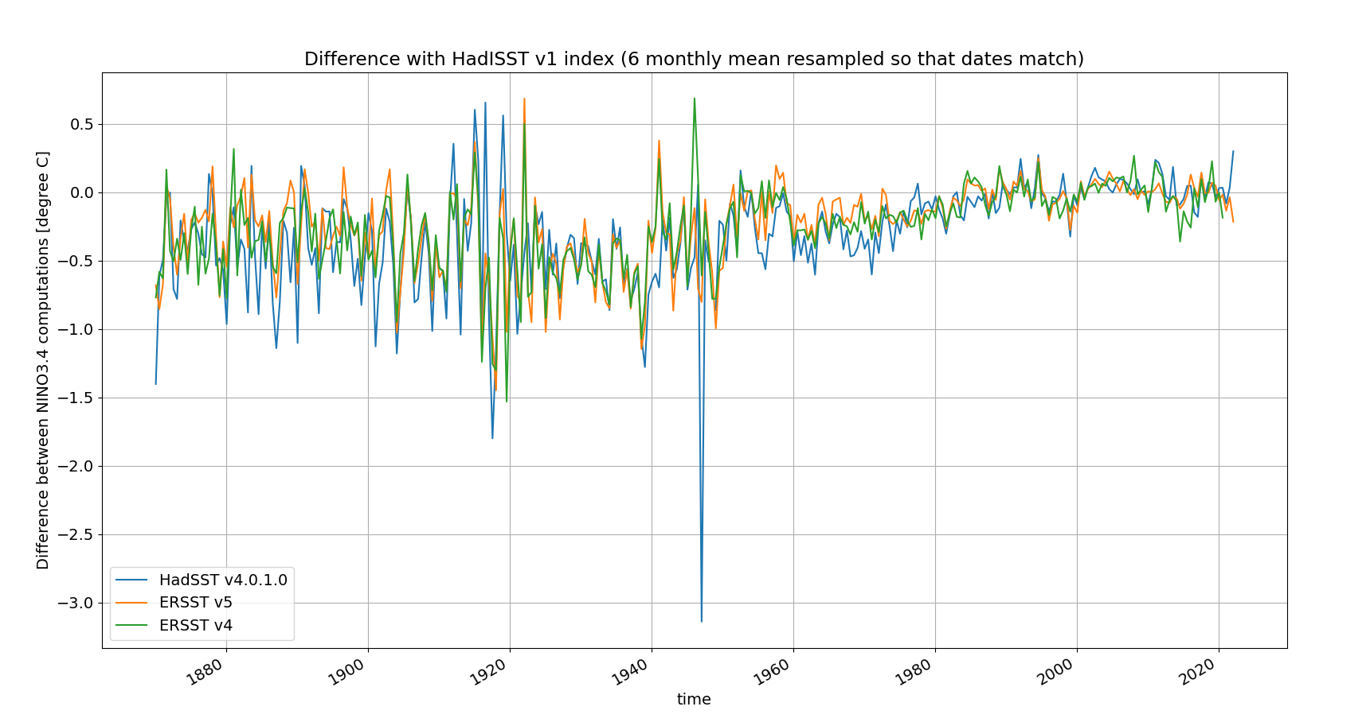

Slide 37
